Slide 1

The Battle of Neighbourhoods - Finding a Better Place in Scarborough, Toronto
Sean Ji

Slide 2
outline
1. Introduction
2. Data Description
3. Methodology
4. Result
5. Problem Solved
6. Conclusion

Slide 3
1. INTRODUCTION
This Project is to help people in exploring better facilities around their neighbourhoods. It will help people to make efficient decisions on selecting great neighbourhoods out of numbers of other neighbourhoods in Scarborough, Toronto.

Slide 4
2. Data Description
1. Scrapped Data Source
Data Source Link: https://en.wikipedia.org/wiki/List_of_postal_codes_of_Canada:_M
Dataset consisting of latitude and longitude, zip codes
2. API Data Source – Foursquare, INCLUDES:
Neighbourhoods
Neighbourhoods Latitude
Neighbourhoods Longitude
Venue
Name of the venue e.g. the name of a store or restaurant
Venue Latitude
Venue Longitude
Venue Category

Slide 5
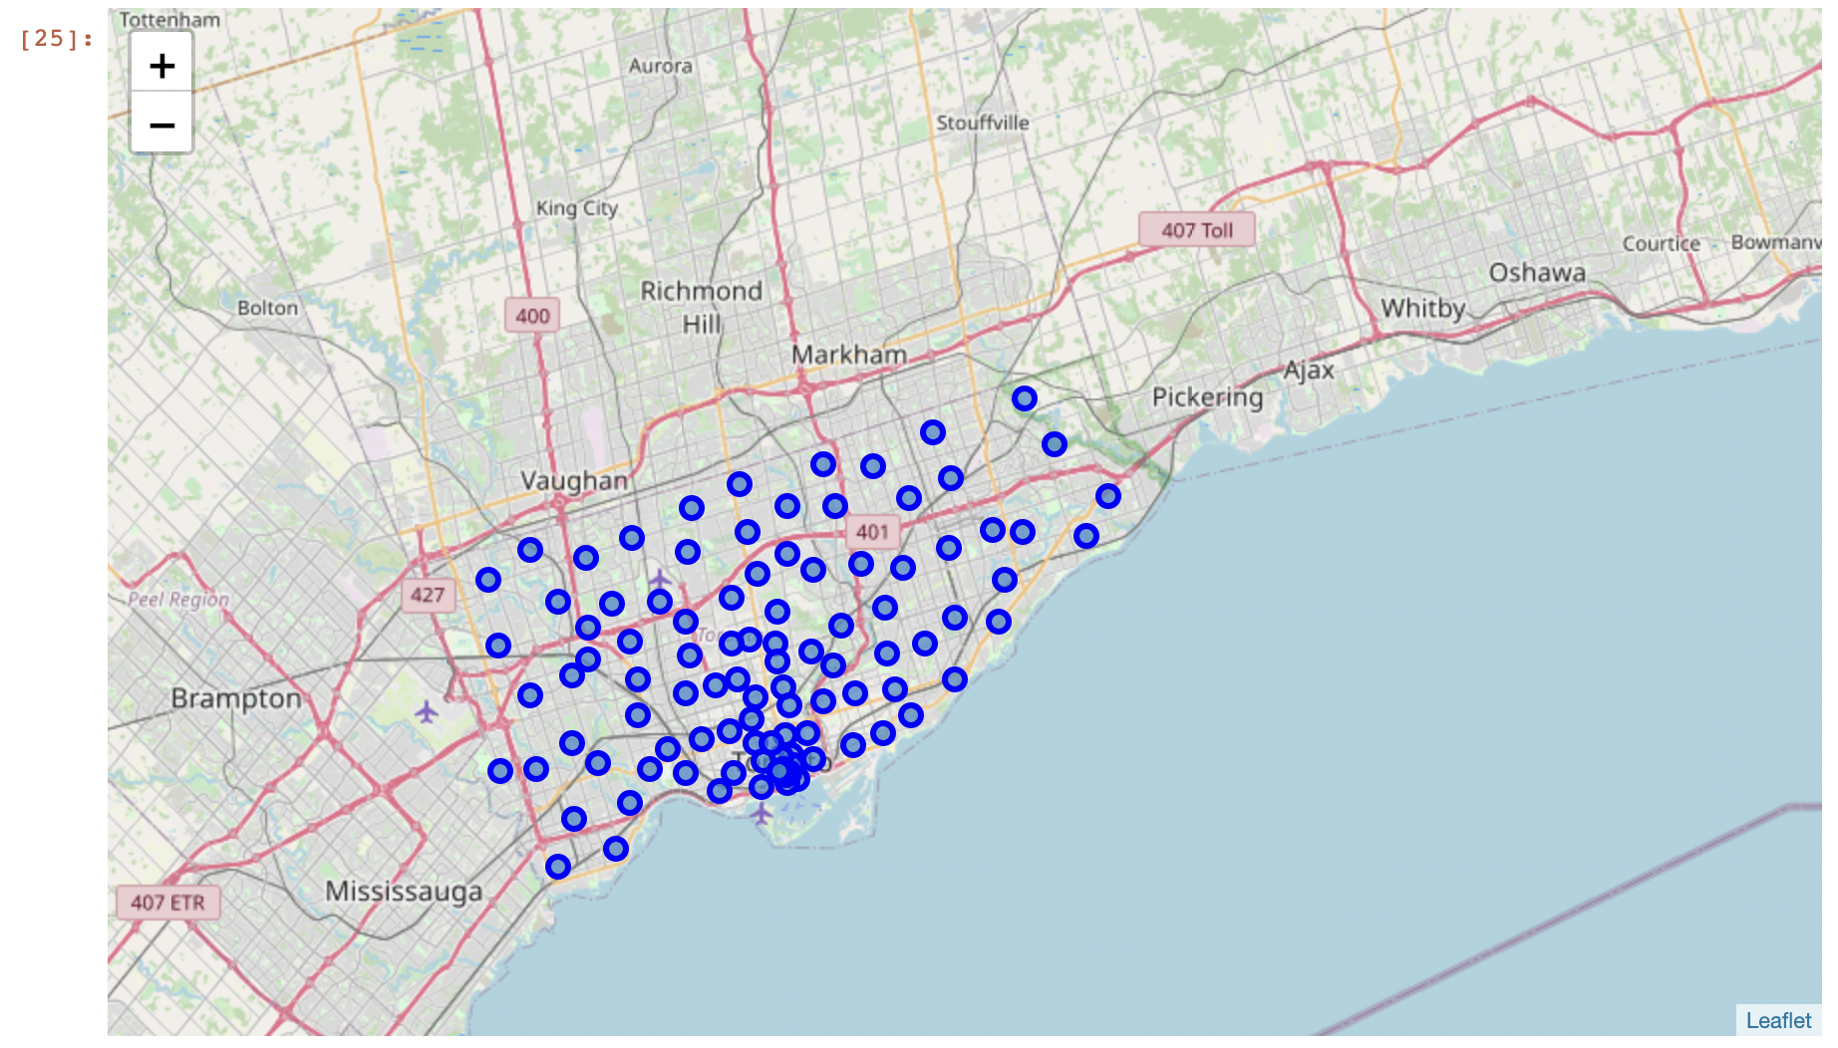
2. Data Description cONT.
3. Map of Scarborough

Slide 6
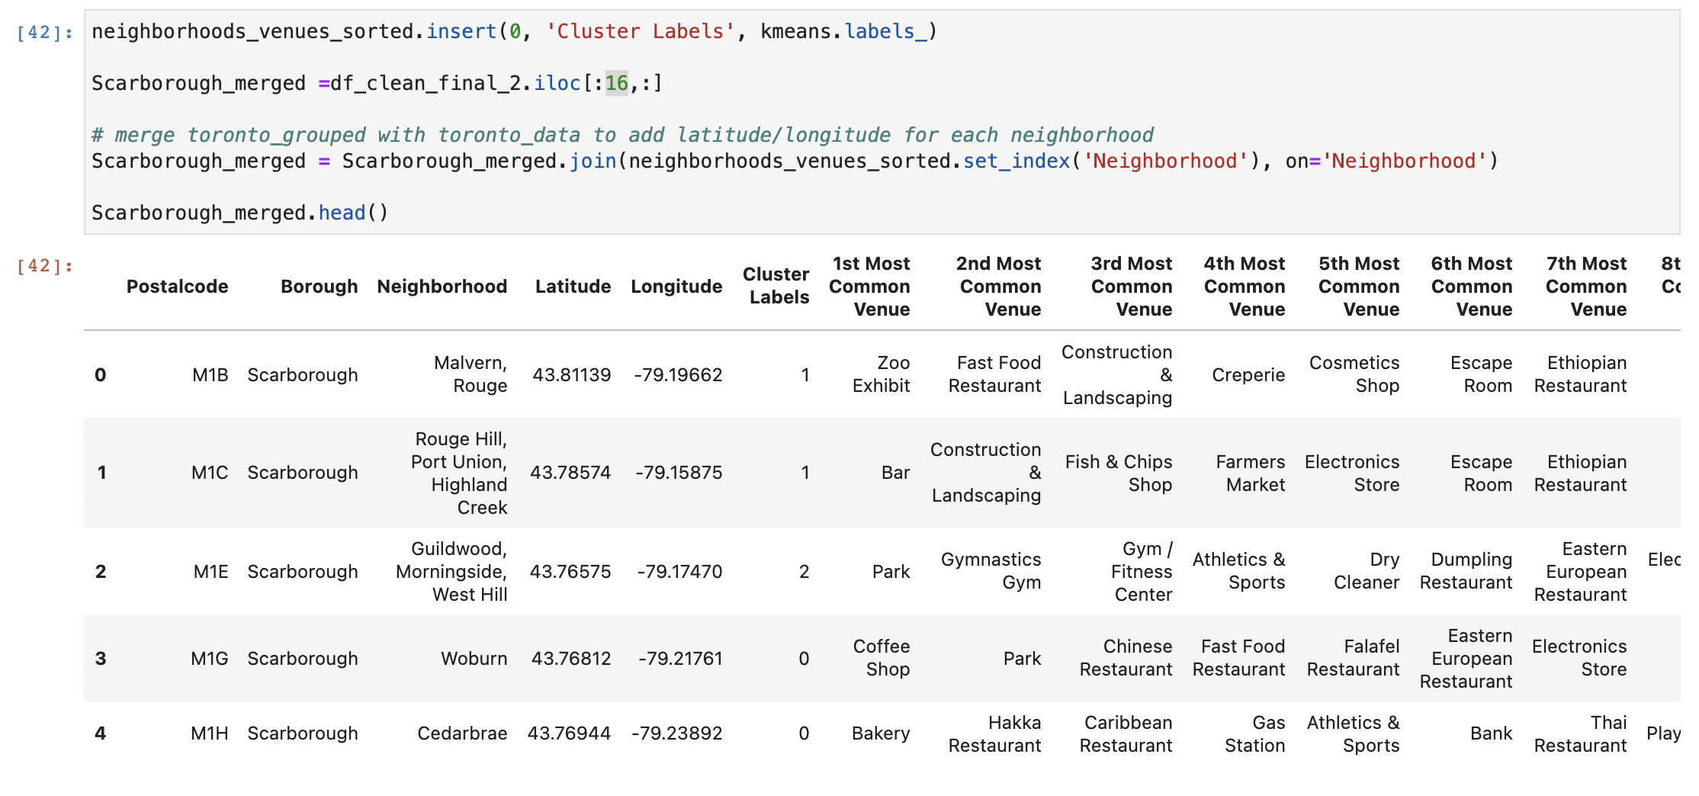
3. Methodology
Clustering Approach
K-Means Clustering Approach

Slide 7
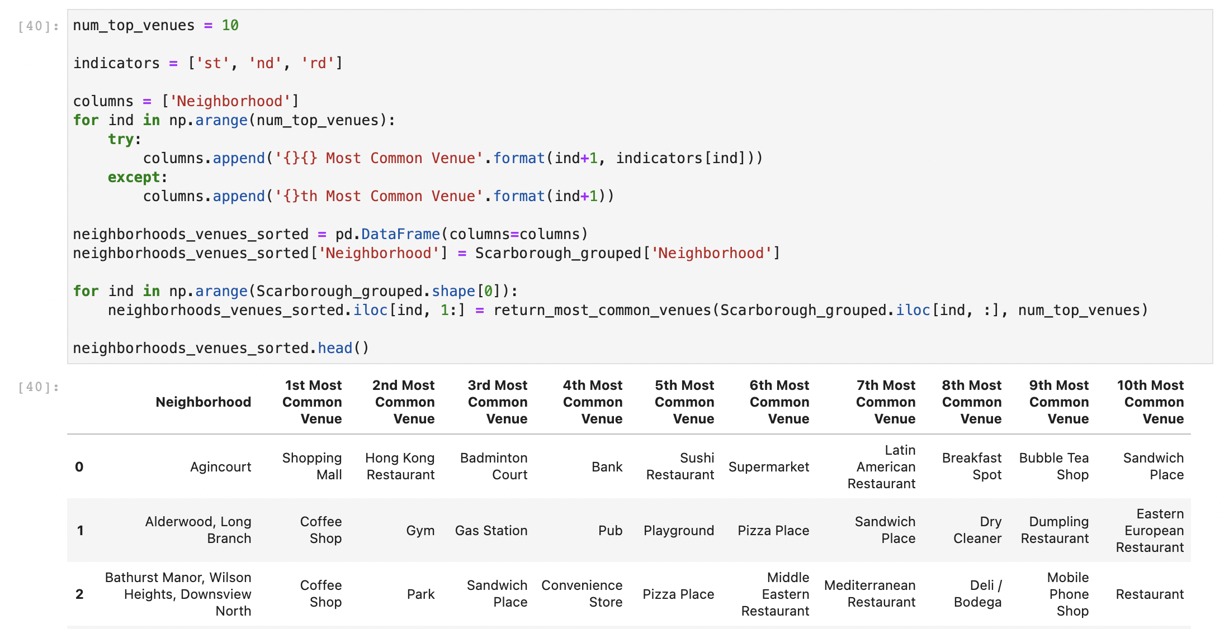
3. Methodology coNT.
Clustering Approach
K-Means Clustering Approach

Slide 8
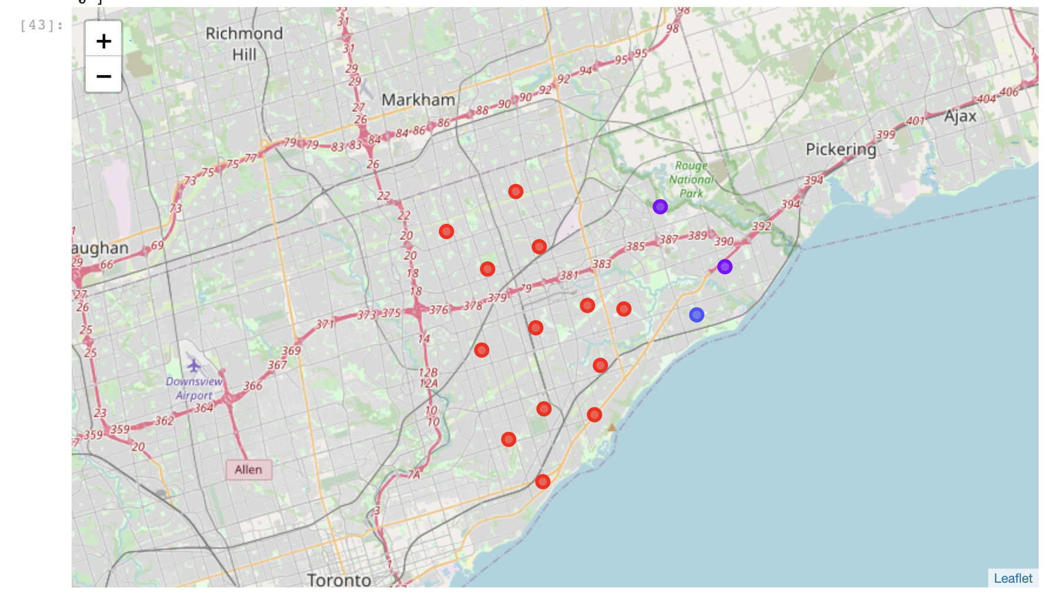
4. Result
1. Map of Clusters in Scarborough

Slide 9
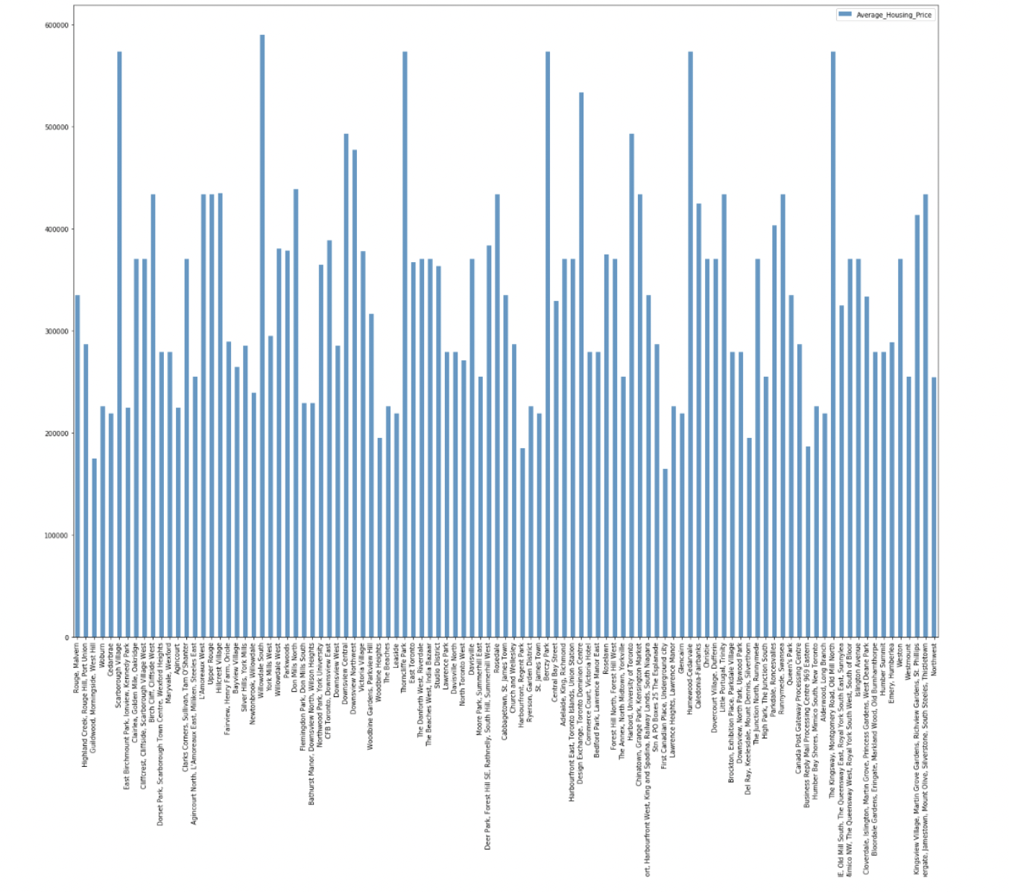
4. Result
2. Average Housing Price by Clusters in Scarborough

Slide 10
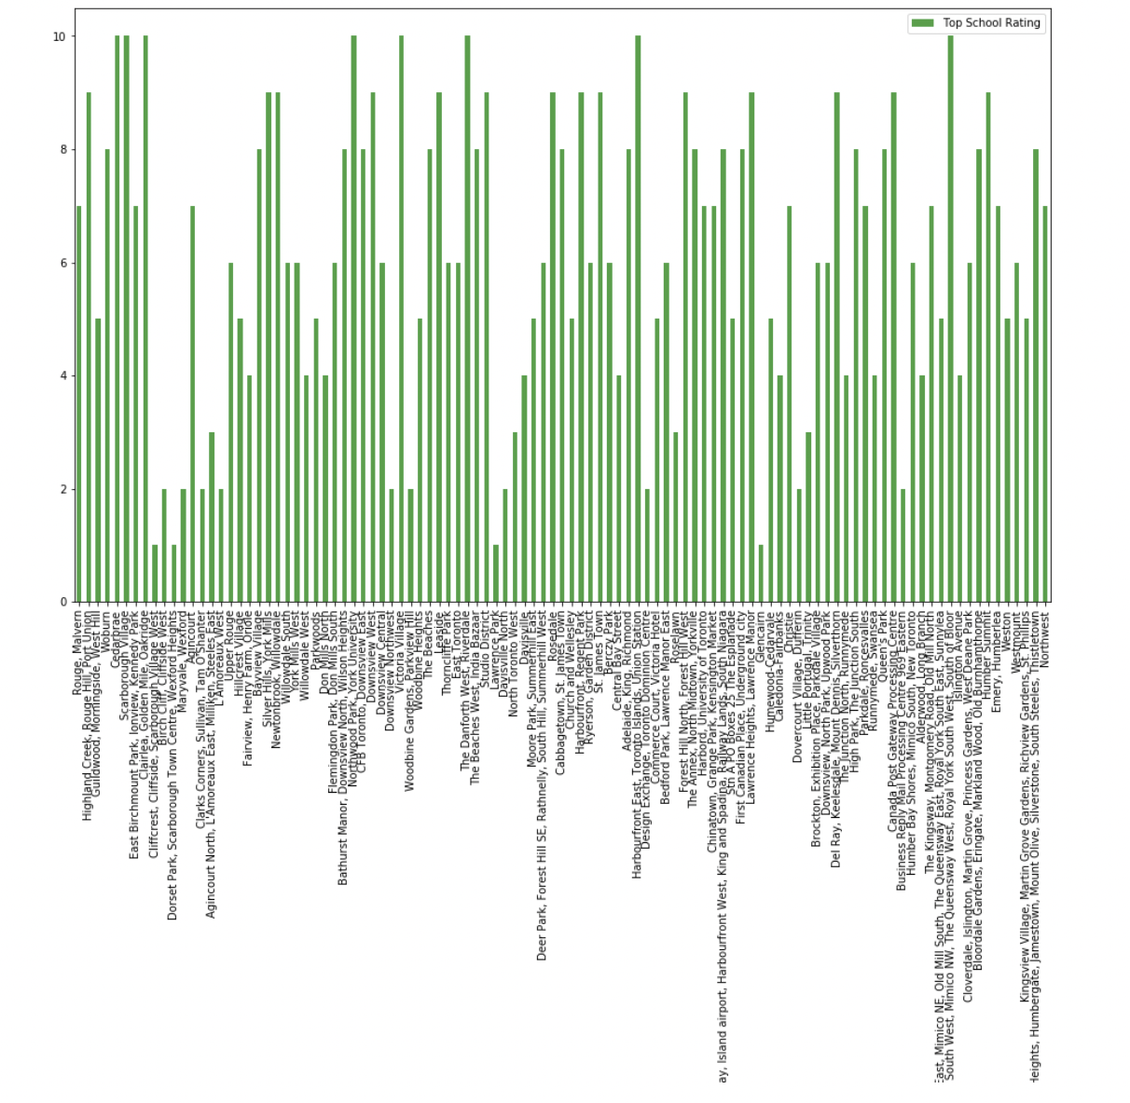
4. Result
3. School Ratings by Clusters in Scarborough

Slide 11
5. Problem solved
Purpose: to suggest a better neighbourhoods in a new city for the person who are shifting there
Solution:
1. Sorted list of house in terms of housing prices in a ascending or descending order
2. Sorted list of schools in terms of location, fees, rating and reviews

Slide 12
5. Conclusion
In this project, using k-means cluster algorithm I separated the neighborhood into 10(Ten) different clusters and for 103 different latitude and longitude from dataset, which have very-similar neighborhoods around them. Using the charts above results presented to a particular neighborhood based on average house prices and school rating have been made.

Slide 13
6. Next step
This project can be continued for making it more precise in terms to find best house in Scarborough. Best means on the basis of all required things(daily needs or things we need to live a better life) around and also in terms of cost effective.

